Slide 1
PA2312044010040 KALKI PRASAD CT-3 Project_WR
File created on: 5/12/2024 4:28:11 PM

Slide 2
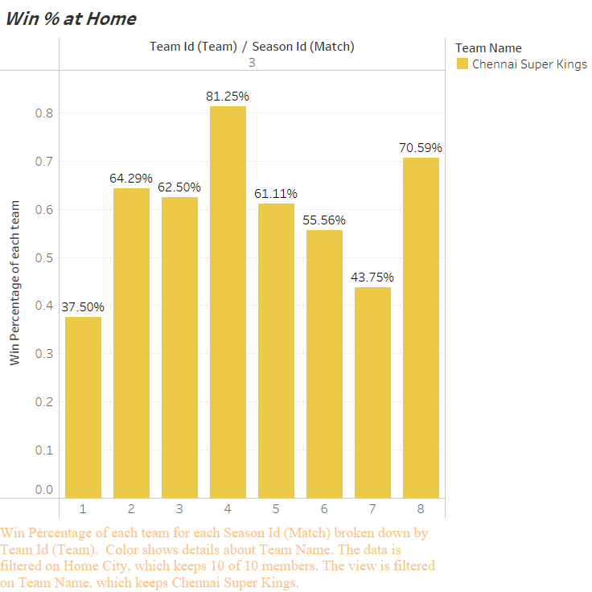

Slide 3
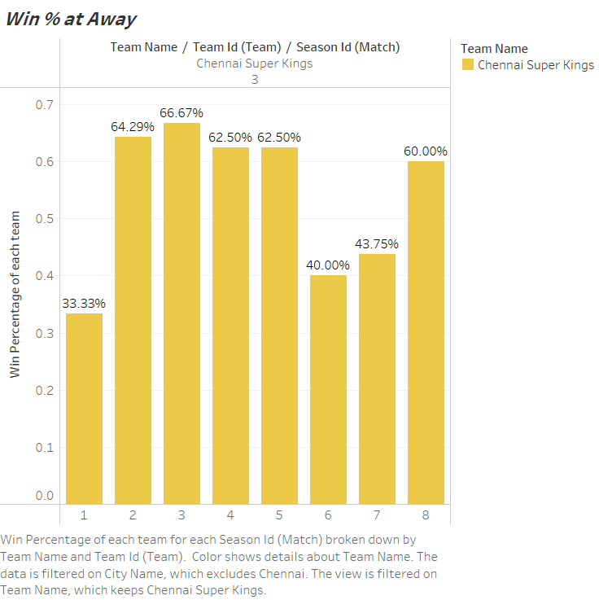

Slide 4
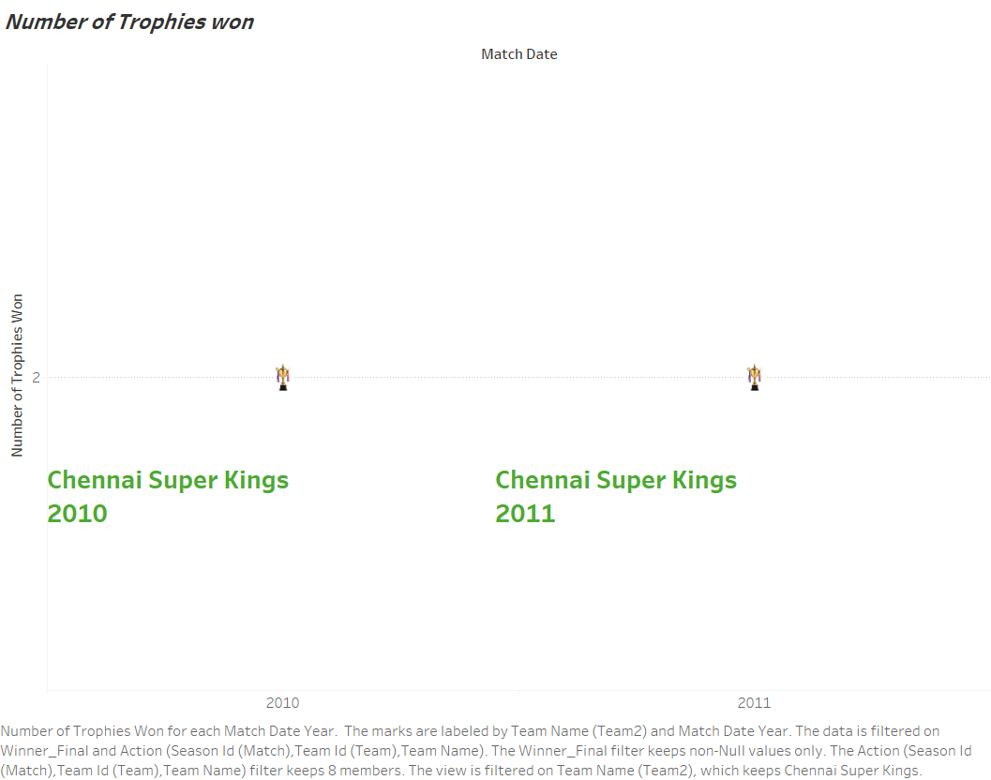

Slide 5
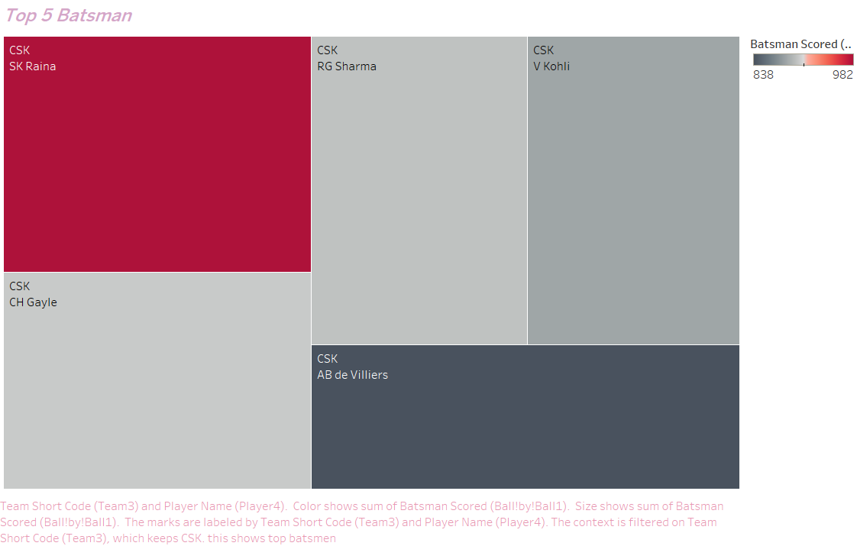

Slide 6
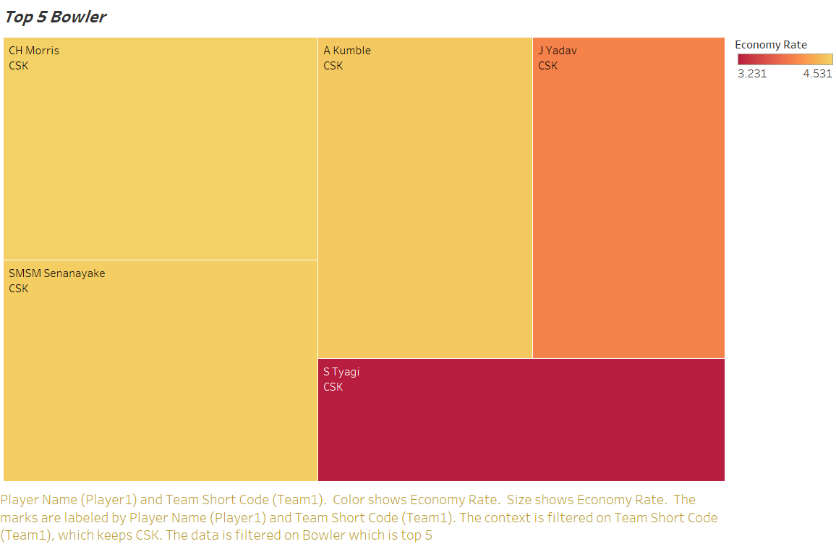

Slide 7
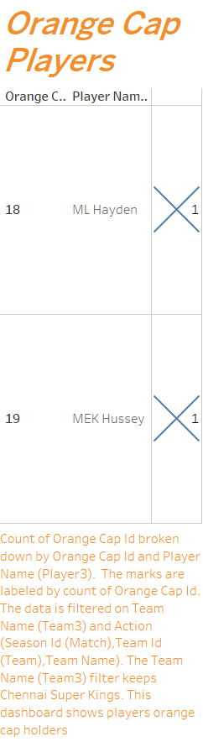

Slide 8
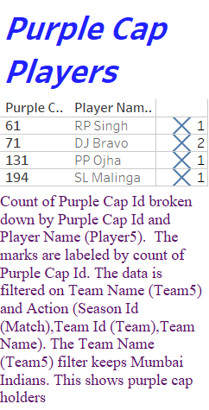

Slide 9
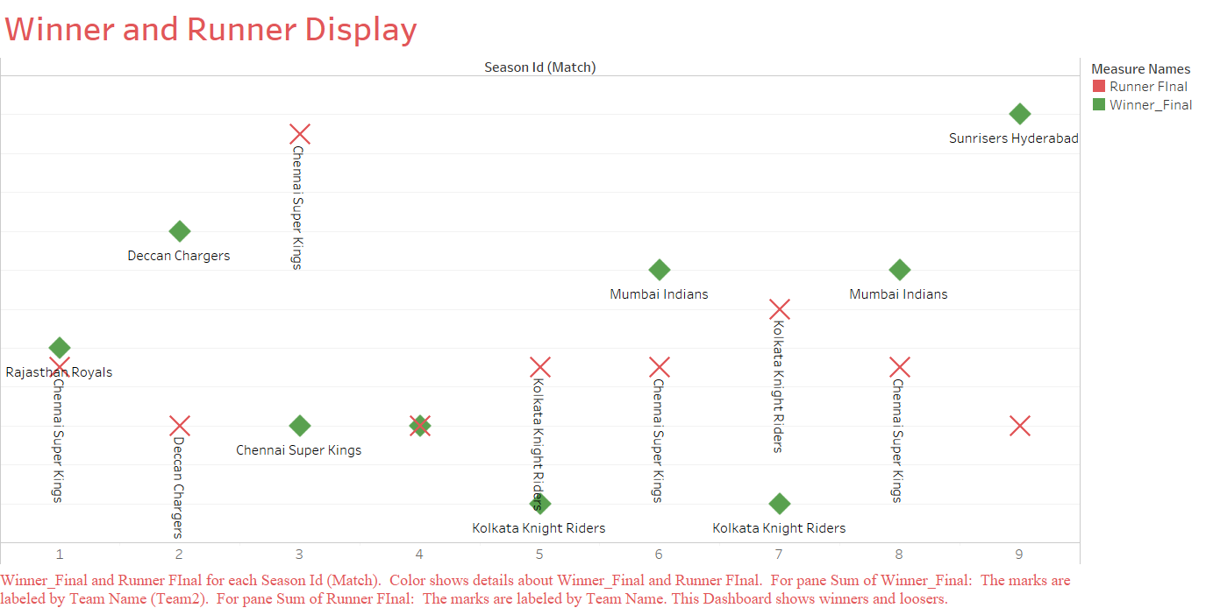

Slide 10
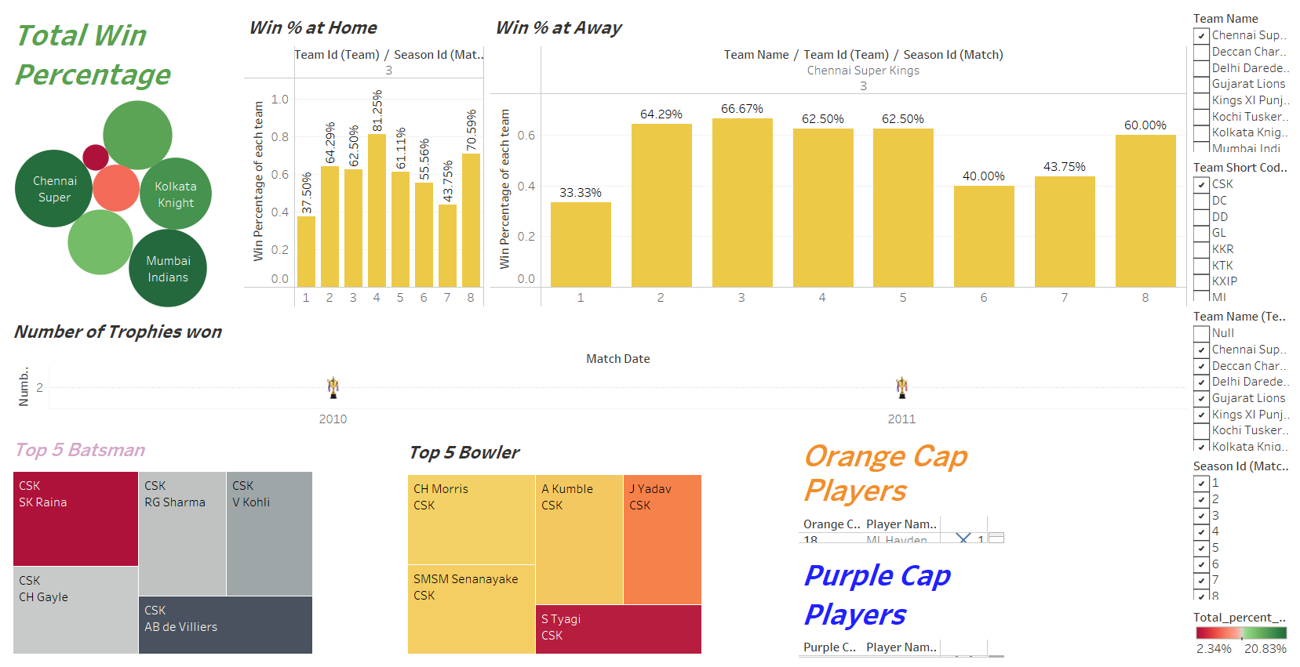

Slide 11
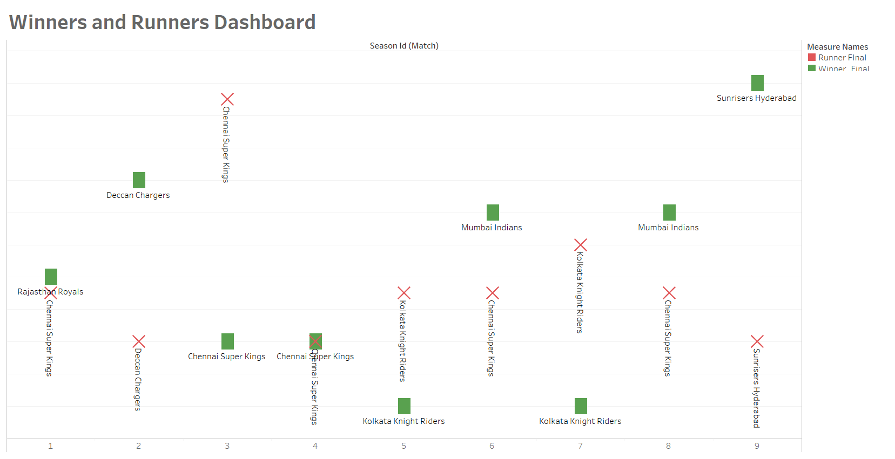

Slide 12
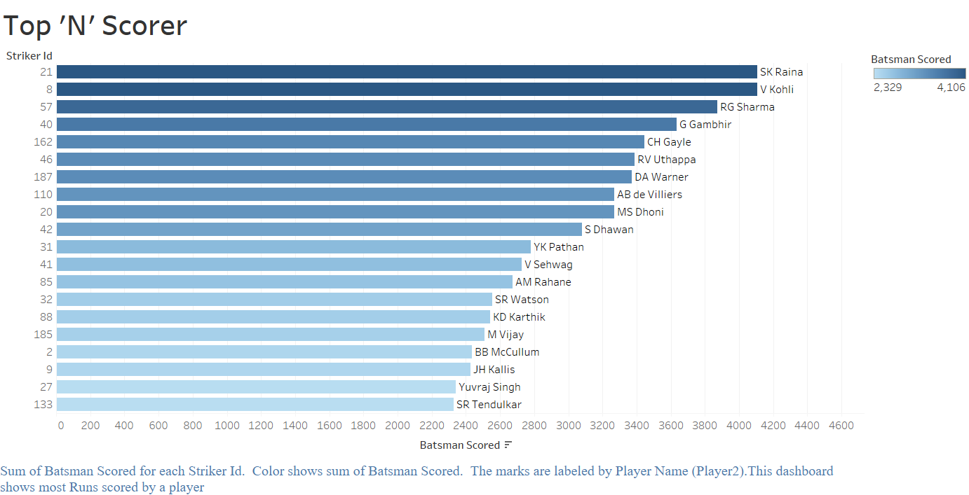

Slide 13
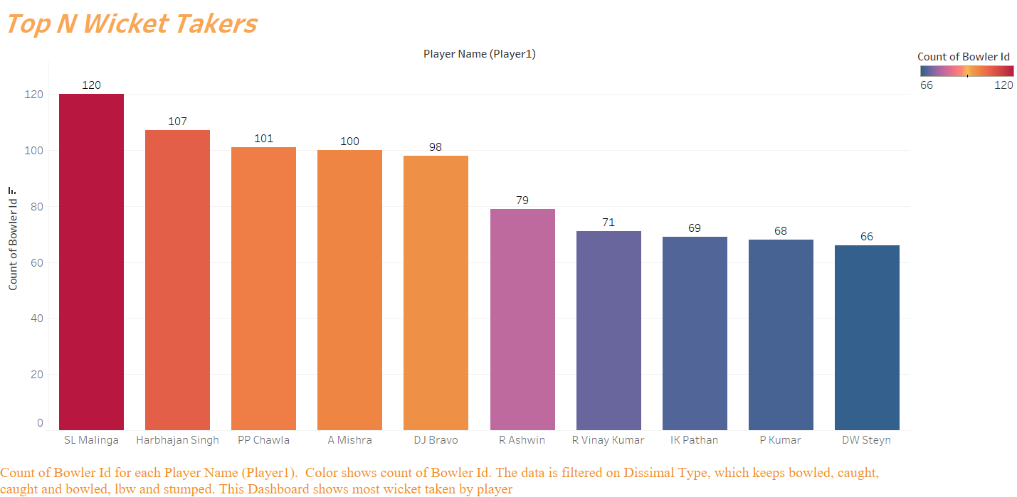

Slide 14
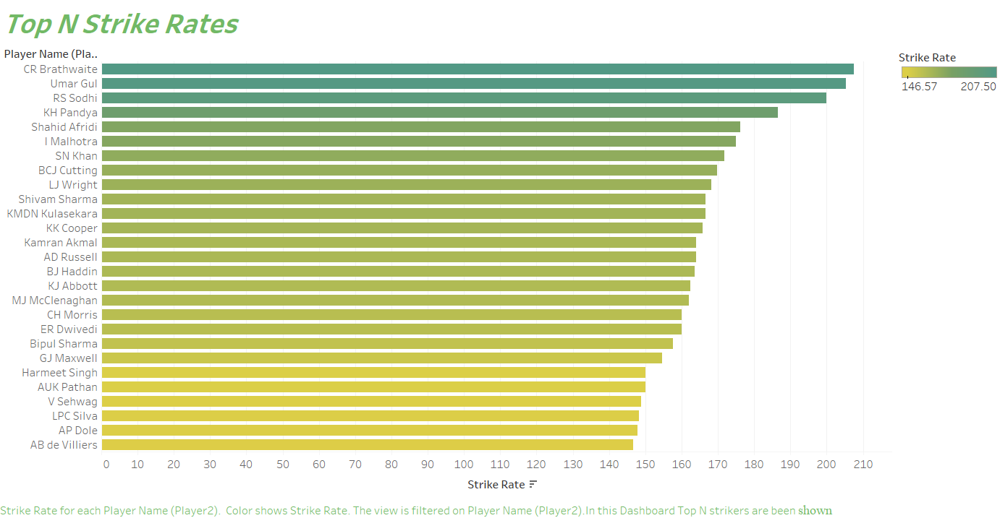

Slide 15
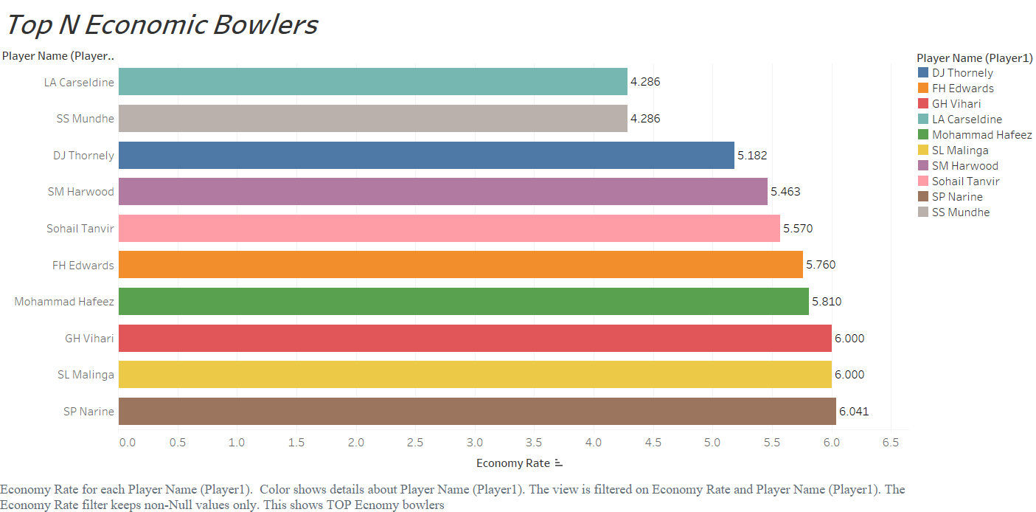

Slide 16
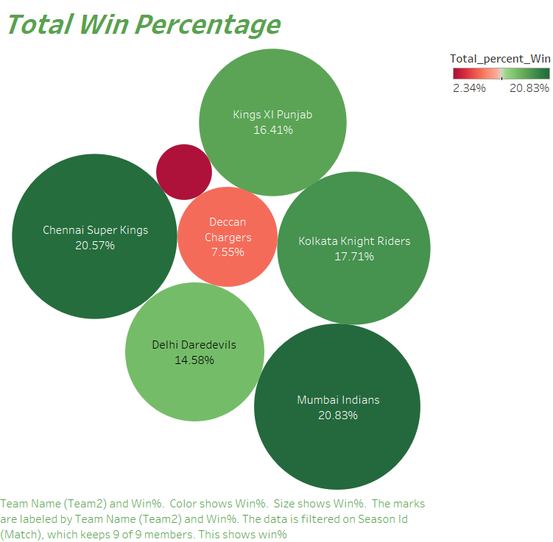

Slide 17
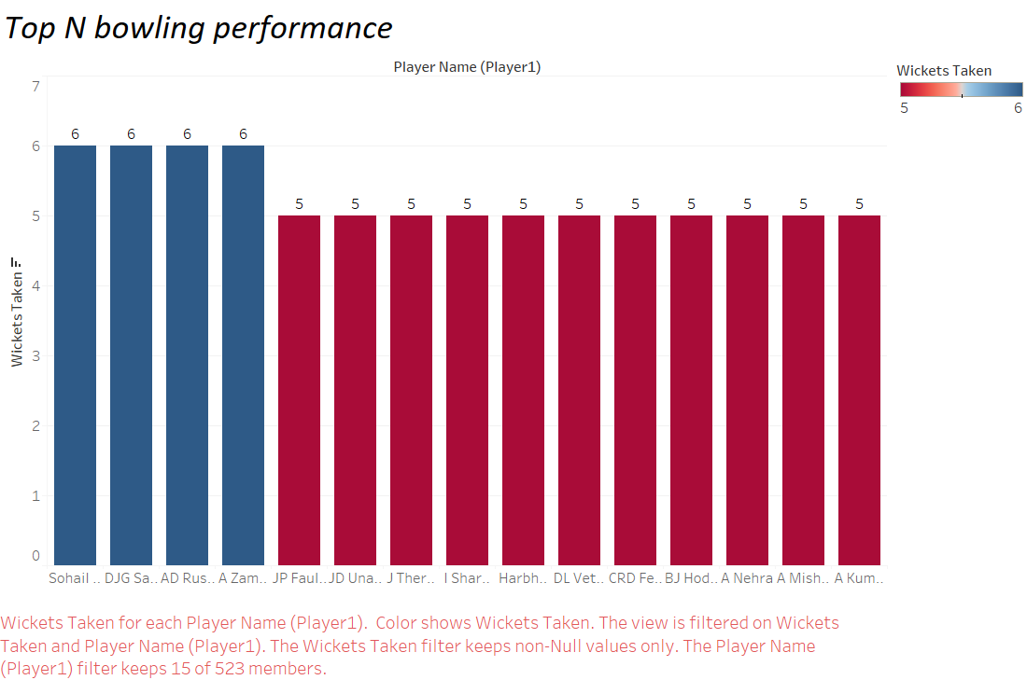

Slide 18
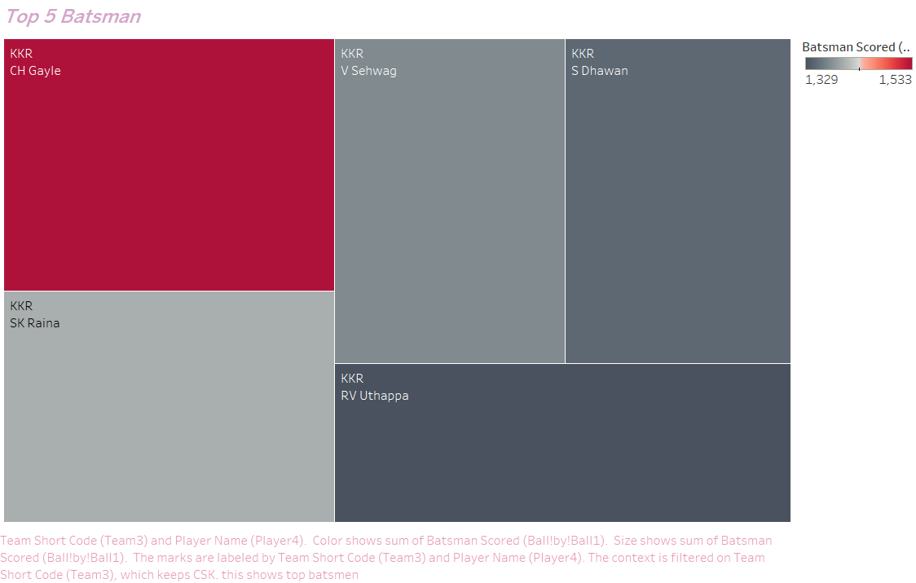

Slide 19
Dashboard Link
https://public.tableau.com/views/PA2312044010040KALKIPRAASDCT-3Project/Dashboard1?:language=en-US&publish=yes&:sid=&:display_count=n&:origin=viz_share_link
https://public.tableau.com/views/PA2312044010040KALKIPRAASDCT-3Project/Dashboard2?:language=en-US&publish=yes&:sid=&:display_count=n&:origin=viz_share_link
Githup link: https://github.com/Kalkiprasath/Kalki

